Slide 1
CIND860 Capstone Project – Evaluating the efficacy of CNN against Traditional ML Models
By: Hasib Chowdhury (500439135)

Slide 2
About Project
For this project, I will use the Fashion MNIST dataset (https://www.kaggle.com/datasets/zalando-research/fashionmnist) from the Kaggle website to conduct the research to fulfill the “Advanced Data Analytics Project (CIND860)” requirements.
Theme: Deep learning

Slide 3
The dataset being used
There are a total of 70,000 images for this dataset, which is split 60,000 for training and 10,000 for testing (comprising of 28x28 grayscale images). This exact dataset is also built-in in the keras library, which shows the exact images (shirts, pants, sneakers, etc.) in its pixel grayscale form as this is not available on Kaggle.
- Train dataset → 60k rows (top 20 pixels were chosen ranked by Importance)
- Test dataset → from the top 20 in the train dataset, the same pixels were replicated, this has 10k rows
- Combined dataset → 70,000 rows with top 20 pixels (values range 0-255) and dependent variable (label)
Notes:
The Kaggle dataset only has 2 .csv files for training and testing for the 784 pixels in the dataset (ranging from 0 to 255 in brightness of the image).
Due to the system crashing, what I did was instead of taking all 784 pixels (as there is a lot of 0’s in the dataset in several rows for a lot of pixels) I took the top 20 pixels on the train set
(which has 60,000 rows) and used RandomForest Importance method (based on 100 trees) to take top 20 pixels and after that I replicated the test set with the exact same 20 pixels and
Combined them together to get a total of 70,000 rows.

Slide 4
Top 20 pixels ranked according to Importance
Rank | Pixel # | Importance
1 | 547 | 0.009806
2 | 603 | 0.009392
3 | 491 | 0.008809
4 | 575 | 0.007279
5 | 263 | 0.006986
6 | 407 | 0.006045
7 | 435 | 0.005642
8 | 687 | 0.005324
9 | 519 | 0.005292
10 | 631 | 0.005287
11 | 401 | 0.005284
12 | 180 | 0.005119
13 | 234 | 0.005010
14 | 236 | 0.004944
15 | 68 | 0.004934
16 | 611 | 0.004891
17 | 96 | 0.004734
18 | 555 | 0.004687
19 | 594 | 0.004502
20 | 427 | 0.004482
Notes:
An embedded technique known as the Random Forest Importance was used to take the top 20 pixels based on the ‘Importance’ value of the Fashion-MNIST train dataset (60,000 rows and 785 columns with column 1 being the dependent variable). The reason top 20 was used was because it is a decent value and the system would not crash (due to limited capabilities) or take a long time to generate a panda profiling report.
The following 20 pixels on the train dataset had the highest importance based on the correlation of the dependent variable (label) and other independent variables (the remaining number of pixels). They do contain a high number of zeros, which were taken into account but of a lesser amount than the other pixels.
The number of trees used to generate this output was 100 trees based on the Random Forest Importance (RFI).
I experimented with different value but chose 100 and used that because Using more trees can lead to a more robust model but might increase computational complexity but using fewer trees might lead to a less complex model but could lead to the model overfitting. The optimal number of trees can depend on factors like the dataset size, complexity, and available computational resources”

Slide 5
Research question
Replicated “Classifying Garments from Fashion-MNIST Dataset Through CNNs” from the ASTESJ Journal (Advances in Science, Technology and Engineering Systems Journal, 2021)
Is CNN's performance practical when compared to traditional machine learning techniques such as Random Forest, SVM or XGBoost?
Notes:
After 1st point:
From the paper, they compared 4 different CNN models and did several tasks around it such as accuracy, validation accuracy, training and validation loss, and training time
In their scenario they used one simple-CNN model and 3 dropout models (with different parameters) and they displayed the accuracy they got in the end along with several other ML models (17 in total)
In my scenario, I chose to compare 4 different ML models as well. However I chose different ML models (CNN-simple, RF, SVM, XGBoost)
In addition, I will also compare CNN with the other 3 models but in various ways such as using different performance measures (precison, recall) and also how it handles different types of
situation

Slide 6
Introduction
Fashion MNIST:
- is a very popular dataset used in several different tasks of deep learning
- holds significant importance for the fashion business industry, serving as a cornerstone in the field of computer vision and machine learning.
“The fashion market has changed dramatically over the last 30 years, resulting in an evolution in that industry. Understanding customer tastes and better-directing sales are the way to increase profit” [3].
“The rise of internet business lets people buy their clothes through websites, faster and easier. The introduction of methods to improve user’s experience when searching for items in these platforms is decisive” [3].
Notes:
In addition, In platforms such as Amazon and E-bay, many consumers are buying their clothing and footwear online in recent years compared to the years prior where they were buying in-person at the store. The trend from retail clothes shopping in store to online shopping has drastically changed, mostly for the better good but there can be issues with online shopping such as fraud with credit cards, but most transactions are secure.
In terms of how Amazon and E-bay play a role with Fashion MNIST in the business market. The AI states that “With the growth of e-commerce platforms like Amazon and eBay, the utilization of Fashion MNIST has gained particular relevance. These platforms, among others, employ machine learning and computer vision techniques to enhance the shopping experience for customers. By using Fashion MNIST, they can develop recommendation systems that suggest products based on a user's previous purchases and preferences, leading to increased customer engagement and sales. Additionally, they can implement image recognition algorithms to enable users to search for items by simply uploading a photo, making the shopping process more convenient and intuitive.” [4]

Slide 7
Literature Review
“Convolutional Neural Network models have been shown efficiency in image classification. This paper presents four different Convolutional Neural Networks models that used Fashion-MNIST dataset. Fashion-MNIST is a dataset made to help researchers finding models to classify this kind of product such as clothes, and the paper that describes it presents a comparison between the main classification methods to find the one that better label this kind of data.
Notes:
In other words, this paper addresses the growing online fashion market's need for algorithms capable of identifying garments. Such algorithms can help companies in the clothing sales sector understand customer preferences, tailor marketing campaigns, and enhance the customer experience while shopping online or at the store. Convolutional Neural Networks (CNNs) are known for their efficiency in image classification, and this paper presents four different CNN models applied to the Fashion-MNIST dataset, I plan to use the same 4 CNN models and see how they are similar or different from one another when I calculate their efficiency, effectiveness, and stability as presented in this paper.
The original research evaluated various machine learning models and achieved 89.7% accuracy using SVM. I will try to use the same technique and see if I end up with the same results (or at least close to it). Also in this paper, the authors propose the use of CNNs to label the Fashion-MNIST dataset, aiming to enhance accuracy. The results show that their new CNN model called "cnn-dropout-3" achieves an accuracy of 99.1%, which was the highest out of all the 15 different models that were tested however it maybe the more time consuming process, which I will investigate.

Slide 8
Data Description
Label Number | Type of Fashion attire
0 | T-shirt/Top
1 | Trouser
2 | Pullover
3 | Dress
4 | Coat
5 | Sandal
6 | Shirt
7 | Sneaker
8 | Bag
9 | Ankle Boot
Notes:
In this dataset, there are a total of 60,000 images of the training dataset and 10,000 images of the test dataset. The 2 .csv files provided on Kaggle provide the details of all 784 pixels (28x28 in terms of height and width) and each pixel on certain labels range from 0-255 (with 0 being light and 255 being very dark). In terms of the labels of the fashion attire in this dataset, they are ranked according to the numbers they represent:
The above table correlates with the labels that were given on Kaggle. In addition, for the training dataset, there are 6,000 labels each for each attire for a grand total of 60,000 fashion images. For the testing however, its a smaller sample size and only 1,000 labels for each attire for a grand total of 10,000 fashion images. The .csv files do not specify the size of the certain clothing like whether certain shirts or trousers are small, medium, or large or whether any type of footwear such as sandals, sneakers, or ankle boots are size 1, 2, etc. and if its gender specific (for males or females).

Slide 9
CNN-Simple modelling
When building a simple-CNN model with the basic parameters:
- 10 epochs, 64 batch size, adam optimizer, ‘categorical crossentropy’ loss
- 75.65% accuracy percent
Research paper being replicated:
- used over 110, 000 trainable parameters
- 99.05% accuracy
Notes:
When comparing the CNN-simple from my own results to the paper:
- It gave 75.65% as the test accuracy, which is much lower than expected mainly cause of the small sample size (70,00 rows) and in the research paper there were over 110,000 trainable parameters, they also received a test accuracy using 2 different TensorFlow versions and in my case I only used the physical dataset with the numbers and one TensorFlow version (most recent version) 2.14.0 and Keras version 2.14.0.
- In addition, the research paper that I am replicating (on section 5.3 cnn-simple, page 992) indicates that “All those models were modeled based on Keras Sequential model. Convolutional and dense layers used Rectified Linear Unit (ReLU) activation functions, except by the last dense layer on each model (output layer), were Softmax was used. The optimizer used was Adadelta, Batch size was 128 and we trained the models for 12 epochs” [2].
- I did this differently from what they did. The reason I chose ‘Adam’ was because I had used it in the past for this exact same dataset in the CIND850 course and in general, it is a popular and effective optimizer that works well generally for many deep learning tasks such as image classification (which is used in this case). The choice of optimizer is problem-specific and I used that but other optimizers like what they used (Adadelta) or other optimizers such as ‘SGD’ or ‘RMSprop’ may also work.

Slide 10
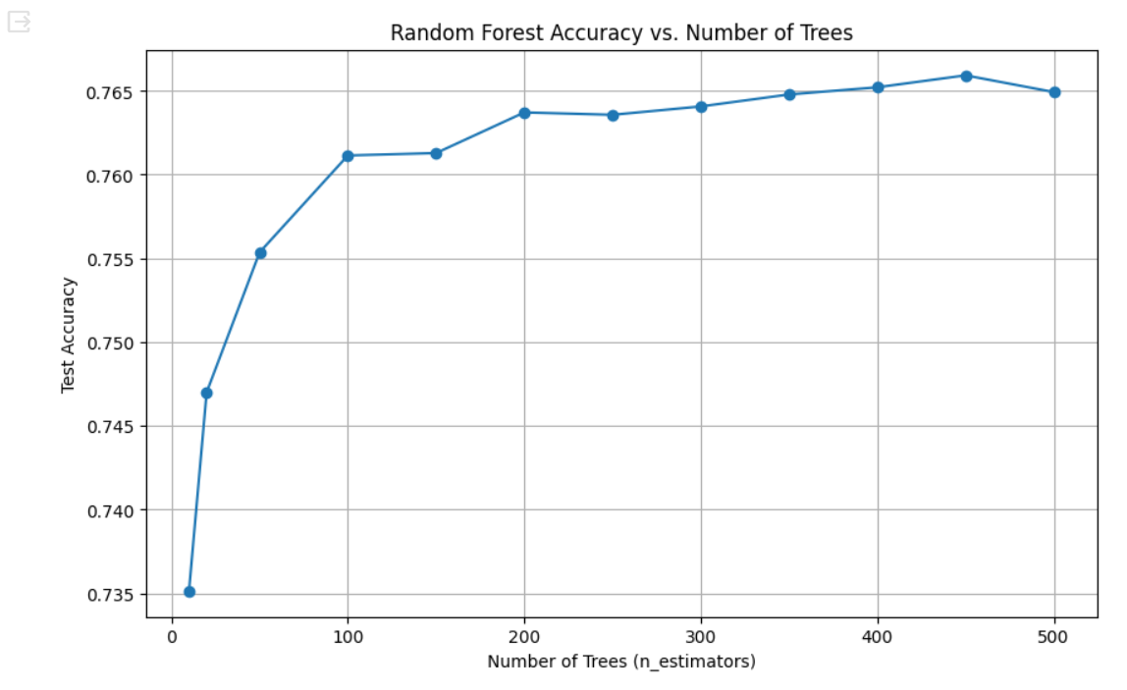
Random Forest Modelling
Notes:
I created a graph to show various accuracies of the number of trees used when doing random forest modelling based on 70,000 rows of the combined data for the top 20 pixels
I used a wide interval between 0-500 trees and a grand total of 12 different values for trees were used in this interval (as shown on the graph above, 12 blue points) and from the looks of this, it stabilizes after 400 trees were compiled.

Slide 11
Random Forest accuracy percentages for each point
Number of trees | Test accuracy
10 | 73.51%
20 | 74.70%
50 | 75.54%
100 | 76.11%
150 | 76.13%
200 | 76.37%
250 | 76.36%
300 | 76.41%
350 | 76.48%
400 | 76.52%
450 | 76.59%
500 | 76.49%
Notes:
When it compiles the ‘500’ tree value, it goes down but 0.10% from the ‘450’ tree value and this output was generated in intervals of 50 trees at a time. So most likely, 450 trees may have been the optimal value to use as this point in the graph is where the line flattens and the accuracy is more or less the same moving forward in the graph.
I used 450 trees in general when comparing randomforest with the other 3 models
In addition, I used max_depth = 10 when executing the code to get the results, so at every 10th level that is where the branch cuts off.

Slide 12
Effectiveness
The effectiveness was compared by the confusion matrix and the classification report for each of the 4 models.
There was one accuracy value given for each model and 10 different precision, recall, and F-1 Scores for each of the 10 total classes (label 0-9)
The overall accuracy of each model was within close range from one another using the same dataset

Slide 13
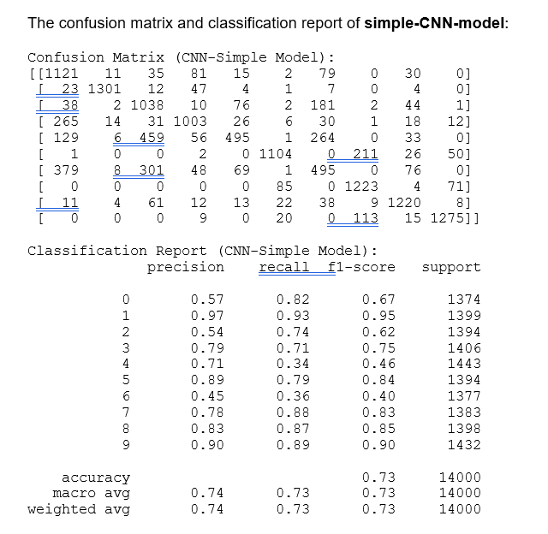
Effectiveness (Simple-CNN)
Notes:
I ended with a 73% accuracy, which is different from the above because the code may have used different values when it did the 80-20 train-test split from the original.
It also shows the precision, recall and accuracy of each specific class one-by-one for all the 10 total fashion attires in the dataset.
Due to the nature of this dataset (even when using random_state=0) the values fluctuate each time the code is run and the numbers change for the confusion matrix and therefore the values for accuracy, precision and recall may also change (but still close to the 70-75% range)

Slide 14
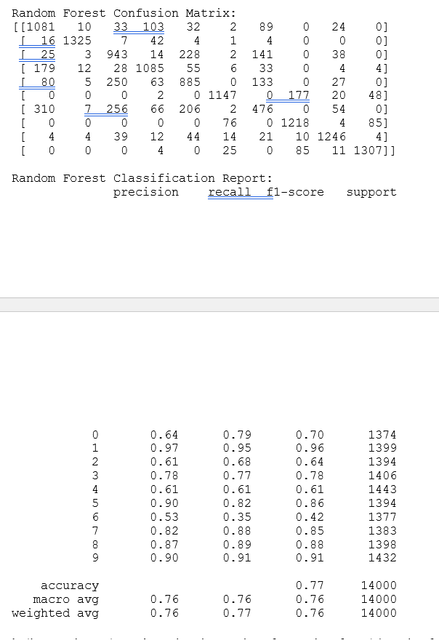
Effectiveness (random forest)

Slide 15
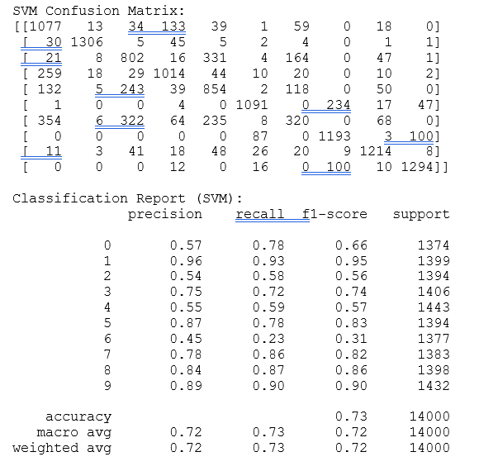
Effectiveness (SVM model)

Slide 16
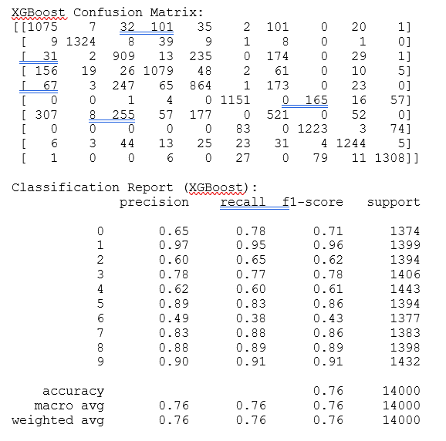
Effectiveness (XGBoost)

Slide 17
Summary report (from previous 4 slides)
Model | Accuracy | Precision (Weighted Avg) | Recall (Weighted Avg) | F1-Score (Weighted Avg)
CNN-Simple | 0.73 | 0.74 | 0.73 | 0.73
RandomForest (400 trees) | 0.77 | 0.76 | 0.77 | 0.76
SVM | 0.73 | 0.72 | 0.73 | 0.72
XGBoost | 0.76 | 0.76 | 0.76 | 0.76
Accuracy Formula: Number of Correct Predictions / Total Number of Predictions
Precision Formula: [True Positives (TP) for class i] / [True Positives (TP) for class i + False Positives (FP) for class i]
Recall Formula: [True Positives (TP) for class i] / [True Positives (TP) for class I + False Negatives (FN) for class i]
Notes:
This is a similar result as to what I had for the test accuracy in the previous stage of this project. The CNN-simple was at 75.68 but decreased to 73%, the other 3 more or less stayed the same. However, in this situation the classification reports now show the precision, Recall, and F1-score which was not discussed earlier. I took the weighted average for all 10 classes to give one final average value for these 3 evaluation measures.
By overall comparison, randomforest had the highest accuracy among the 4 models at 77% and CNN-simple & XGBoost had moderate accuracies, whereas SVM had the lowest accuracy. The reason randomforest had the highest was because 400 trees were used and could have been less if smaller values were used.

Slide 18
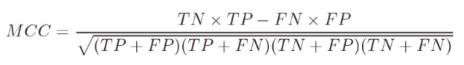
Matthew’s Correlation coefficient
Model | MCC
Simple-CNN | 0.700483
Random Forest (400 trees) | 0.739932
SVM | 0.697171
XGBoost | 0.738379

Slide 19
Efficiency
For efficiency, 2 different categories were used: Training/Testing time for each of the 4 models along with the memory consumption
Model | Training time (seconds) | Testing time (seconds)
CNN-simple | 25.40 | 1.04
Random Forest (400 trees) | 33.90 | 0.76
SVM | 71.45 | 33.54
XGBoost | 14.33 | 0.26
Model | Peak Memory (MB) | Memory Increment (MB)
CNN-simple | 5759.64 | 1.16
Random Forest (400 trees) | 6526.09 | 735.34
SVM | 6124.08 | 14.78
XGBoost | 6593.18 | 0.00

Slide 20
Stability
K-fold cross validation was used in this criteria, I used 10-fold specifically for getting 10 different folds’ accuracy and putting them in an array to get the variance.
The table below gives the mean accuracy and variance done on the train set only (60,000 rows).
Model | Mean Accuracy | Variance
CNN-simple | 73.6650 | 0.6754
Random Forest (400 trees) | 76.4633 | 0.2190
SVM | 72.6917 | 0.2548
XGBoost | 76.3783 | 0.1238

Slide 21
Stability (continued)
After getting the mean accuracy for train set, I compared it to the test set (10,000 rows) and here are the results for each model (no k-fold, just one accuracy value):
Model | Accuracy on test set
Simple-CNN | 73.52%
Random Forest (400 trees) | 76.29%
SVM | 72.75%
XGBoost | 76.40%

Slide 22
Research limitation, challenges faced, and suggestion for improvement
The research done had it’s limitations
- used a sample size of the top 20 pixels (ranked according to importance) instead of the whole dataset
- system crashed if too much data was being used so this was one of the ways it was done
Research paper being replicated:
- most likely used the image data as in some scenarios mentioned used over 100,000 parameters which wasn’t possible to do.
- Ended with giving accuracy values only in the high 90’s for the top 4 models, whereas mine gave 72-76 (different models)

Slide 23
Conclusion
Going back to the main research question that I investigated:
“Is CNN's performance practical when compared to traditional machine learning techniques such as Random Forest, SVM or XGBoost?”
In terms of results (comparing the 4 models):
- tied for the lowest accuracy out of all the 4 models
- 3rd best when comparing MCC
- 2nd fastest in training/test time
- overall consistent with the other 3 models that were compared to but did have its flaws.

Slide 24
Research question excluded (but in abstract)
“How the CNN's performance compared to other models like LeNet-5, VGGNet, ZFNet, or ResNet?”
This could be used in future research work when comparing the different types of ‘Net’ models to the simple-CNN
Had issues with coding some of it, so left out.

Slide 25
References (same as on final report)
Xiao, H., Rasul, K., & Vollgraf, R. (2017). Fashion-mnist: a novel image dataset for benchmarking machine learning algorithms. arXiv preprint arXiv:1708.07747.
Kayed, M., Anter, A., & Mohamed, H. (2020, February). Classification of garments from fashion MNIST dataset using CNN LeNet-5 architecture. In 2020 international conference on innovative trends in communication and computer engineering (ITCE) (pp. 238-243). IEEE.
LEITHARDT, V. (2021). Classifying garments from fashion-MNIST dataset through CNNs. Advances in Science, Technology and Engineering Systems Journal, 6(1), 989-994.
OpenAI. (2023). ChatGPT (GPT-3.5 model) [Large language model]. https://chat.openai.com/chat
Stephanie Glen. "Matthews Correlation Coefficient" From StatisticsHowTo.com: Elementary Statistics for the rest of us! https://www.statisticshowto.com/matthews-correlation-coefficient/ → used for MCC formula
Bressler, N. [November 23, 2022]. How to Check the Accuracy of Your Machine Learning Model. Deepchecks. → used for Accuracy formula
https://deepchecks.com/how-to-check-the-accuracy-of-your-machine-learning-model/

